Slide 1
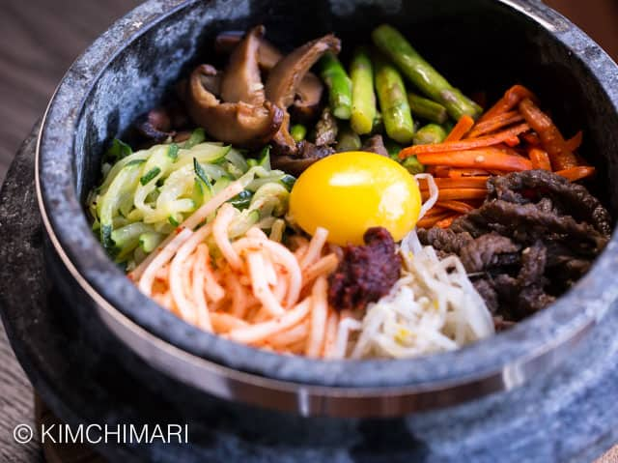
Home
About us
Menu
Gallery
Contact
K-TOWN
ENJOY THE BEST AUTHENTIC KOREAN CUISINE AT K-TOWN!
We serve the University City, Philadelphia area with the best Korean dishes. Our restaurant offers bibimbap, various hot pots, barbecue meats, chicken dishes, and potstickers. Served with rice and side dishes. A selection of K-pop music completes the atmosphere in our restaurant. We offer dine-in service and takeout. We hope to see you soon.

Slide 2
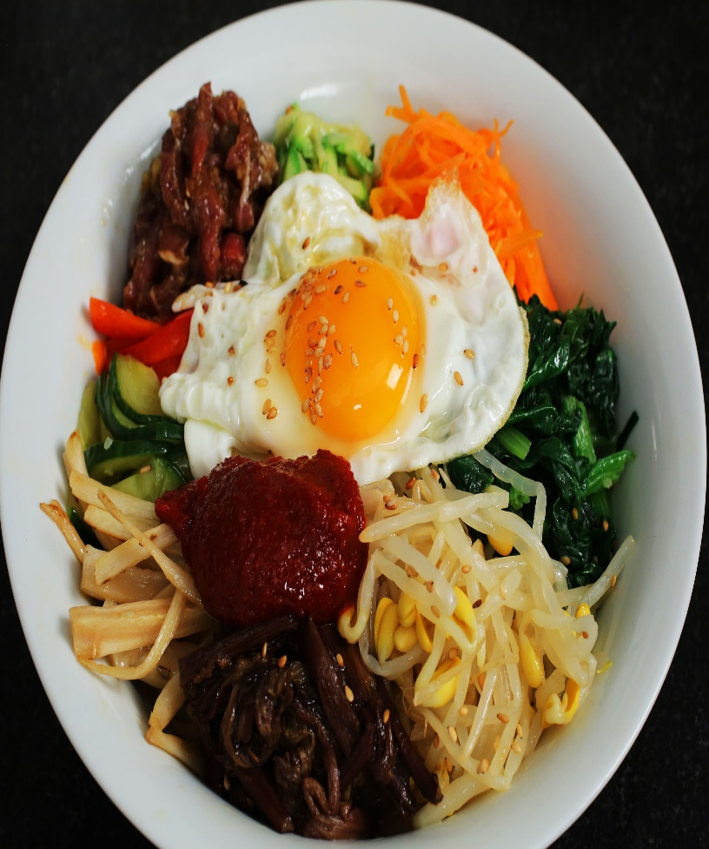
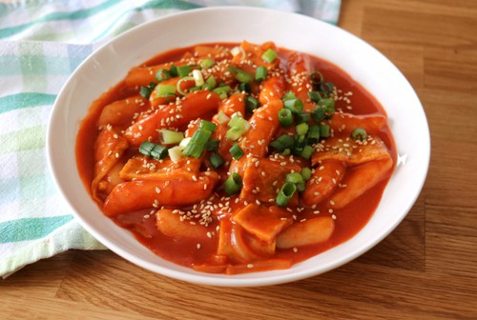
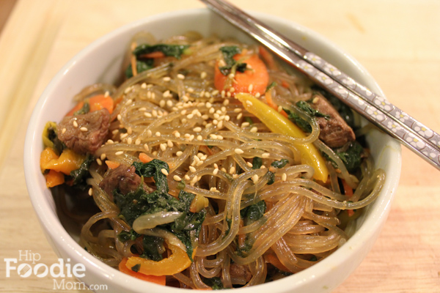
Home
About Us
Menu
Gallery
Contact
1.Bibimbap (mixed rice)
2.Tteokbokki
3.Chapchae(Stir fried noodles)

Slide 3
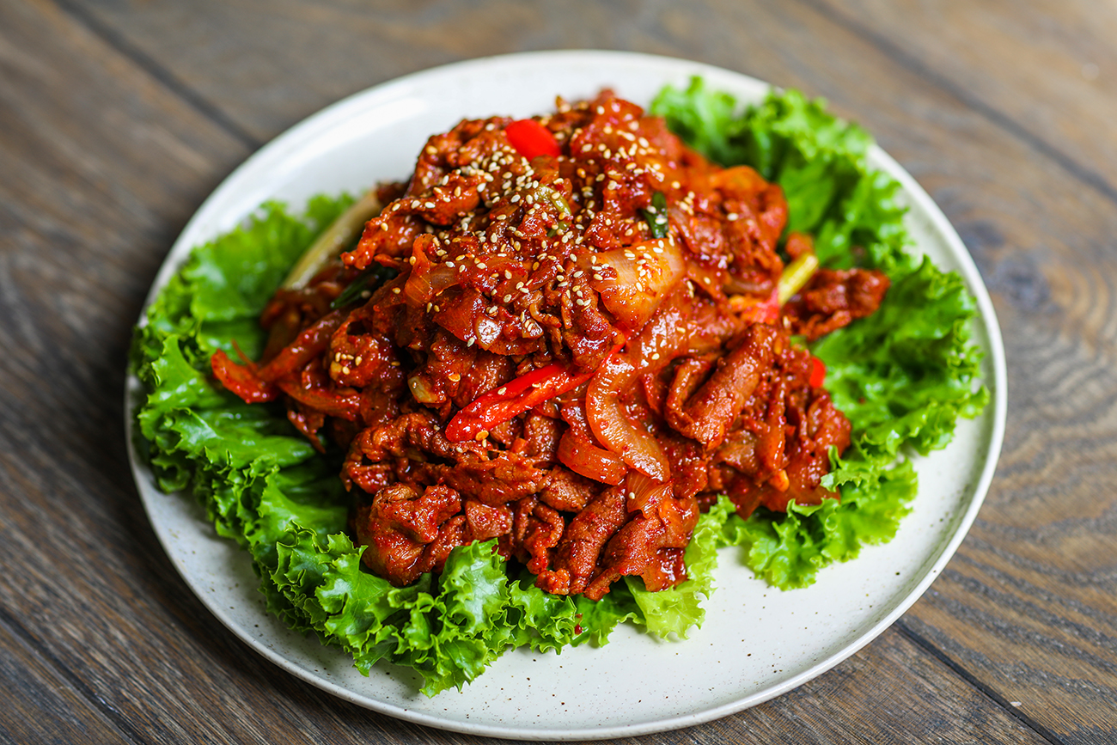
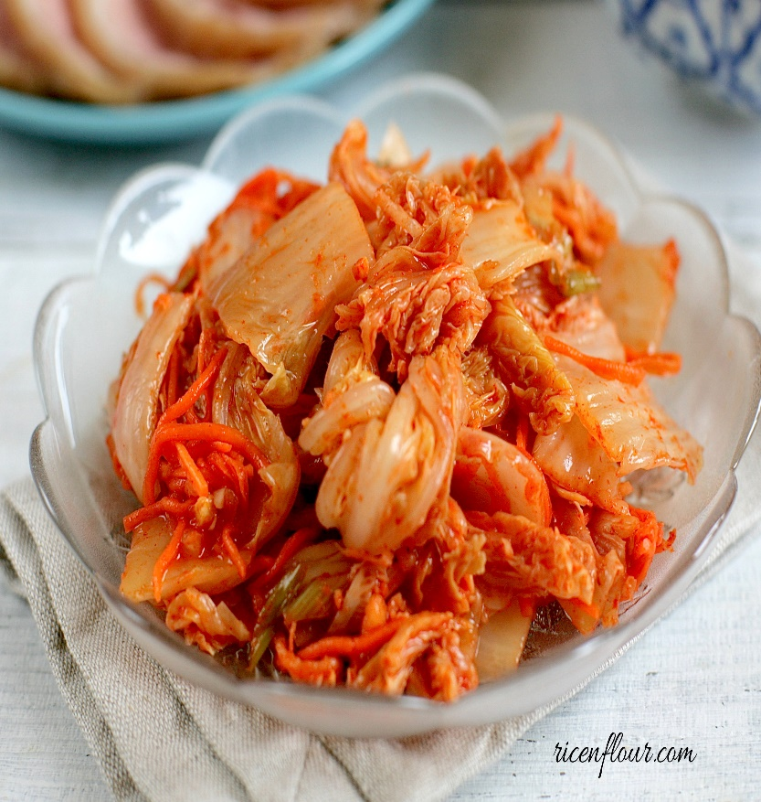
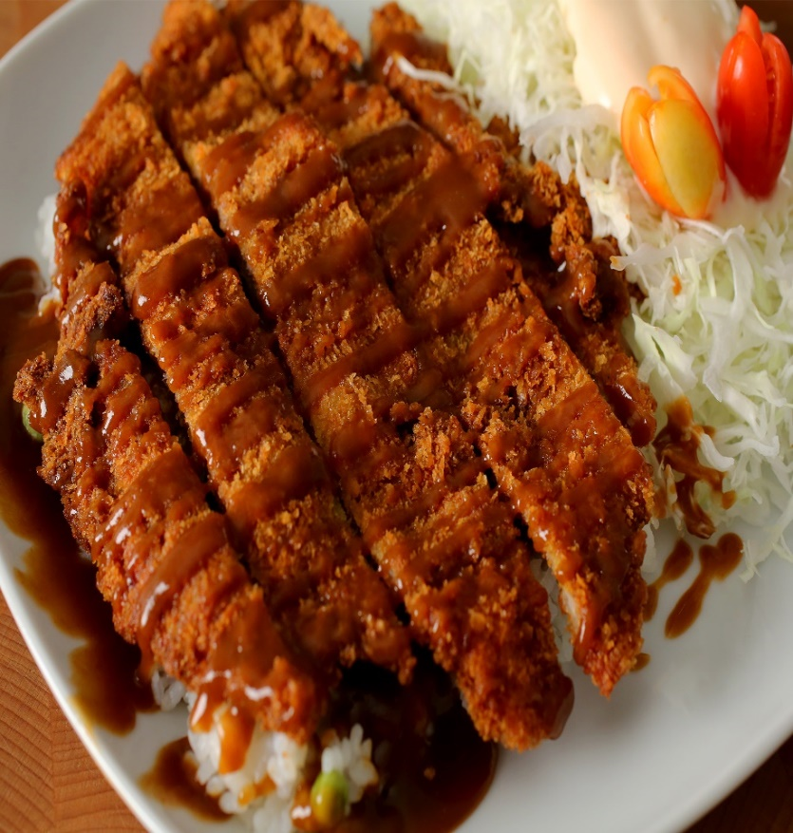
Home
About us
Menu
Gallery
Contact
Home
4. Pork Bulgogi (Daeji Bulgogi )
5. Chili Pickled Cabbage (Kimchi )
6.Donkkaseu(Pork cutlet)

Slide 4
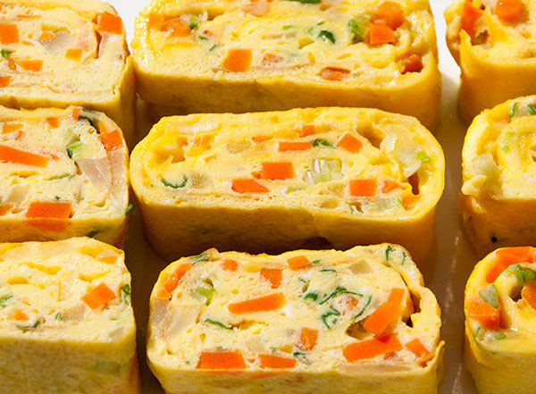
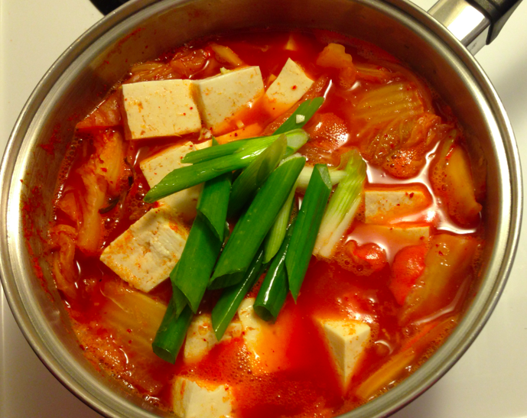
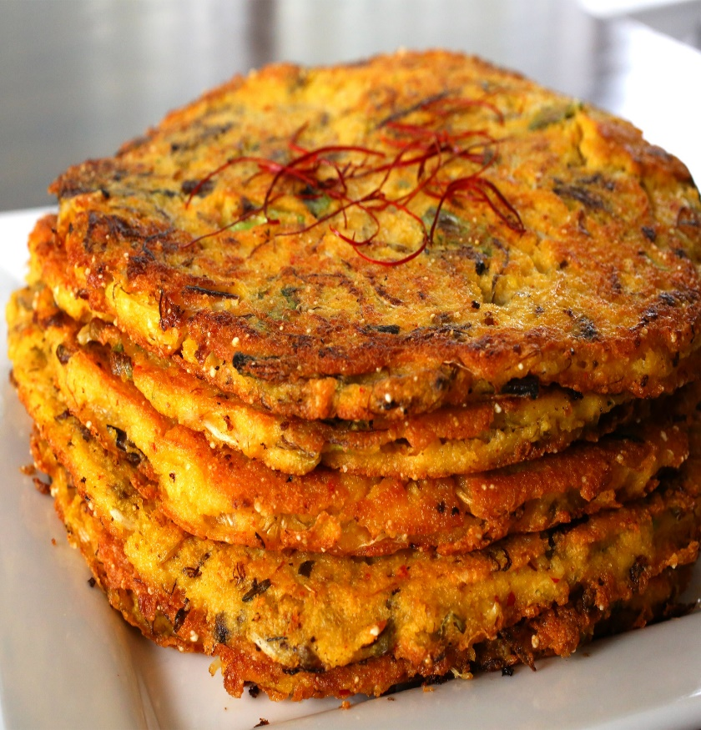
Home
About us
Menu
Gallery
Contact
7. Korean Egg Roll
8. Kimchi Stew
9.Bindaettok(Mung bean paste)

